Slide 1
Introduction to Cyber Security
COMP3134 Week 4

Slide 2
Overview
Objective
Transport layer hijacking
Application layer hijacking
Main Teaching Points
Exploitation tactic 1: Infiltrating and taking over
Learning Outcome(s)
Implement various tactics to attack a network or application

Slide 3
Transport Layer Hijacking

Slide 4
Transport Layer Hijacking
Definition
Get authentication to an active system
4 Step process
Find active session
Predict sequence number
Take a party offline
Take control of session

Slide 5
Find Active Session
Also know as Session Hijacking
Scenario 1: Attacker and victim are on a hub
Passive Sniffing
Scenario 2: Attacker and victim are on a switch
Active Sniffing
Goal is to get sequence & acknowledge numbers
Scenario 3: Attacker and victim are not on the same network
Blind (brute) sequence prediction
Modern OS implement random sequence numbers

Slide 6
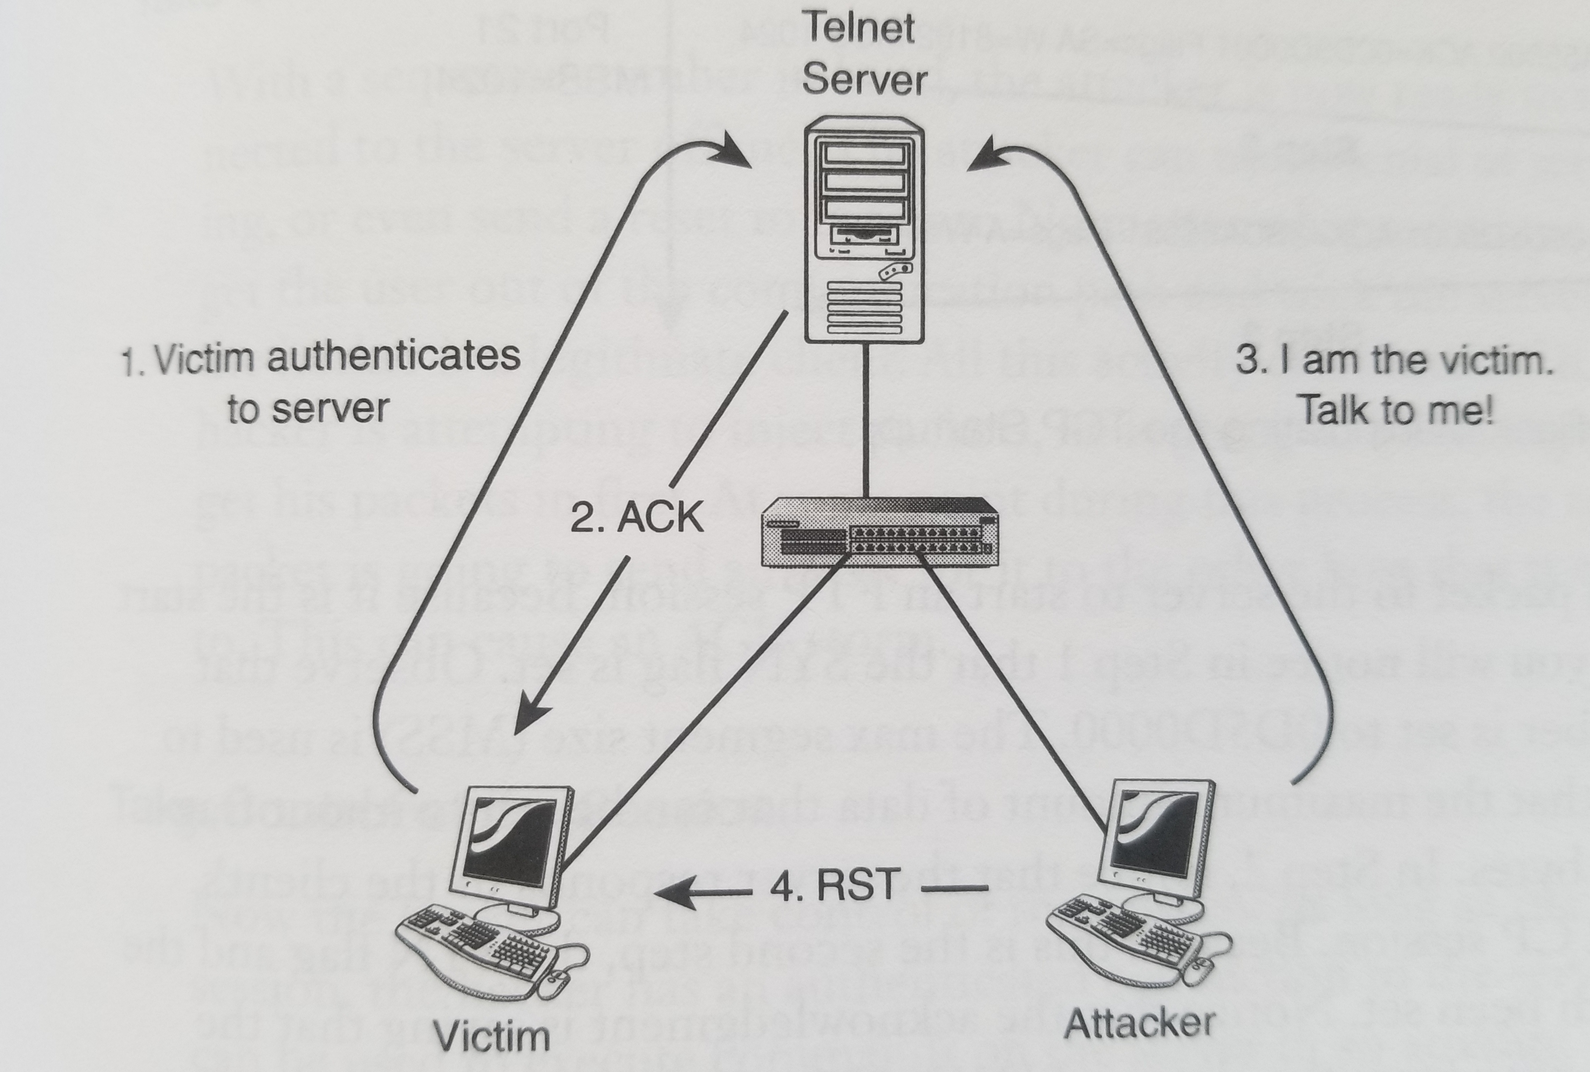
Hijacking a Session

Slide 7
Predict Sequence Number
Can be done using TCP protocol
3-Step Handshake
Sequence numbers
Missing data detection
Flow control
4-Step shutdown process
Session termination process if somethings goes wrong

Slide 8
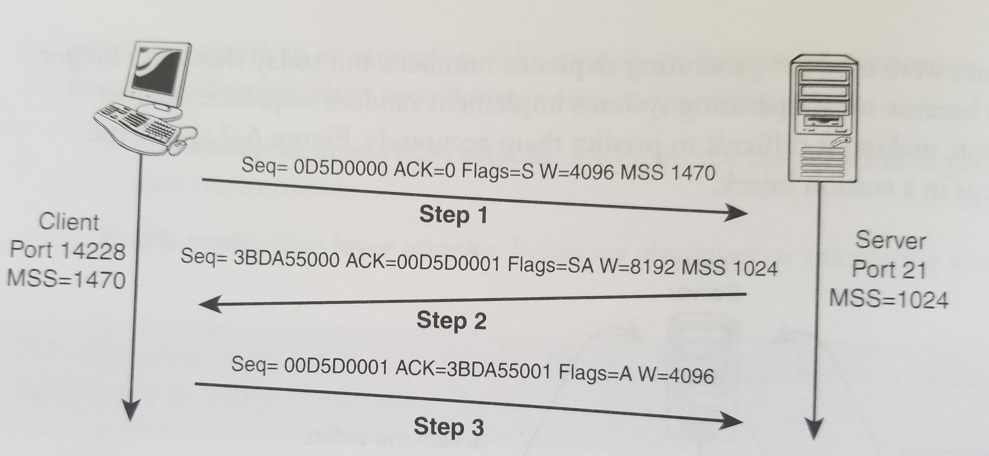
Predict Sequence Number
In TCP every byte of data must have sequence number
Used to keep track of data

Slide 9
Take Party Offline
When do you want to inject packets?
Before session ends
After authentication occurs
Take user offline
Sending RST flag
DoS
Attacker tricks server to believing attacker is a real connection

Slide 10
Application Layer Hijacking

Slide 11
Application Layer Hijacking
Definition
Steal or predict a session token
Tactics include
Predictable session token ID
Man-in-the-middle attacks
Man-In-the-browser attacks
Comparison:
Taking a delivered package from someone’s doorstep

Slide 12
Application Layer Hijacking Tactics
Predictable session token ID
Applications have session tokens for authentication
Algorithms may be weak or predictable
Man-in-the-middle attacks
When attacker gets between client and server data exchange
Man-In-the-browser attacks
Victim’s system is infected by virus
Requests are sent without victim’s knowledge

Slide 13
Transport /Application Layer Hijacking
Implication
Trust can be spoofed
Application
Tools used included
Wireshark
PacketSender
Demo

Slide 14
Terms to Know
Transport Layer Hijacking
Application Layer Hijacking
Find Active Session
Predict Sequence Number
Take Party Offline
Predictable session token ID
Man-in-the-middle attacks
Man-In-the-browser attacks

Slide 15
Resources
Websites
Session Hijacking
https://www.geeksforgeeks.org/session-hijacking/
Session Prediction
https://owasp.org/www-community/attacks/Session_Prediction
Videos
Man-In-The-Middle-Attack
https://www.youtube.com/watch?v=_QtSB0Old_Q

